Slide 1
MIT 6.875
Foundations of Cryptography
Lecture 23

Slide 2
Security against Malicious (Active) Adversaries

Slide 3




Secure Two-Party Comp: New Def
(possibly randomized) $F\left(x,y;r\right)=(F_{A}\left(x,y;r\right), F_{B}(x,y;r))$
Input: $x$
Input: $y$
Alice
Bob
There exists a PPT simulator ${SIM}_{A}$ such that for any $x$ and $y$:
(${SIM}_{A}\left(x,F_{A}\left(x,y\right)\right),F(x,y)$) $≅$ (${View}_{A}(x,y),F(x,y)$)
i.e. the joint distribution of the view and the output is correct

Slide 4
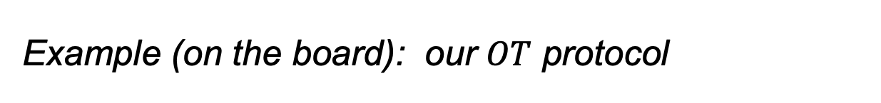
Issues to Handle
1. Input (In)dependence: A malicious party could choose her input to depend on Bob’s, something she cannot do in the ideal world.
Example (on the board): $F\left(\left(a,b\right), x\right)=(⊥,ax+b)$
2. Randomness: A malicious party could choose her “random string” in the protocol the way she wants, something she cannot do in the ideal world.
Example (on the board): our $OT$ protocol
Cleve’s theorem: this is unavoidable
3. (Un)fairness: A malicious party could block the honest party from learning the output, while learning it herself.
4. Deviate from Other Protocol Instructions.

Slide 5

New (Less) Ideal Model
$$y$$
$$x$$
$$F(x,y)$$
$$abort?$$
If not $abort:$
$$F(x,y)$$

Slide 6
The “GMW Compiler”
Theorem [Goldreich-Micali-Wigderson’87]: Assuming one-way functions exist, there is a general way to transform any semi-honest secure protocol computing a (possibly randomized) function F into a maliciously secure protocol for F.

Slide 7
Input Independence
1. Input (In)dependence: A malicious party could choose her input to depend on Bob’s, something she cannot do in the ideal world.
Solution: Each party commits to their input in sequence, and provides a zero-knowledge proof of knowledge of the underlying input.

Slide 8
Solution: Coin-Tossing Protocol
2. Randomness: A malicious party could choose her “random string” in the protocol the way she wants, something she cannot do in the ideal world.
Def: Realize the functionality $F\left(1^{n},1^{n}\right)=(r,Com(r))$.
$$Com(r_{1})$$
$$r_{2}$$
Output $r=r_{1}⊕r_{2}$
Output $(Com\left(r_{1}\right), r_{2})$

Slide 9
Zero Knowledge Proofs
4. Deviate from Other Protocol Instructions.
Solution: Each message of each party is a deterministic function of their input, their random coins and messages from party B.
When party A sends a message $m=m(x_{A},r_{A},\overline{{msg}_{B}})$, they also prove in zero-knowledge that they did so correctly. That is, they prove in ZK the following NP statement:
$\left(m,\overline{{msg}_{B}},XCom,RCom\right): ∃ x_{A},r_{A}$ s.t. $m=m\left(x_{A},r_{A},\overline{{msg}_{B}}\right) ∧$ $XCom=Com\left(x_{A}\right)∧$
$$RCom=Com\left(r_{A}\right)$$

Slide 10
Optimizations

Slide 11
Optimization 1: Preprocessing OTs
Random OT tuple (or AND tuple, or Beaver tuple after D. Beaver): Alice has $(α,γ_{a})$ and Bob has $(β,γ_{b})$ which are random s.t. $γ_{a}⊕γ_{b}=αβ$.
Theorem: Given O(1) many random OT tuples, we can do OT with information-theoretic security, exchanging O(1) bits.

Slide 12
Optimization 2: OT Extension
Theorem [Beaver’96, Ishai-Kushilevitz-Nissim-Pinkas’03]:
Given O($λ$) many random OT tuples, we can generate $n$ OT tuples exchanging O($n$) bits --- as opposed to the trivial O($nλ$) bits --- and using only symmetric-key crypto.

Slide 13
Complexity of the 2-party solution
Number of OT protocol invocations $=2 ∗ \#AND$ gates
Can be made into O(#inputs $∙λ$): Yao’s garbled circuits
Number of rounds = AND-depth of the circuit
Can be made into O(1) rounds: Yao’s garbled circuits
Communication in bits = $$O(\#AND∙λ+\#outputs)$$
Can be made into O($λ$ #inputs) using FHE: but FHE is computationally more expensive concretely.

Slide 14
Secure Multi Party Computation w/ Information-theoretic security

Slide 15
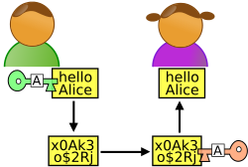

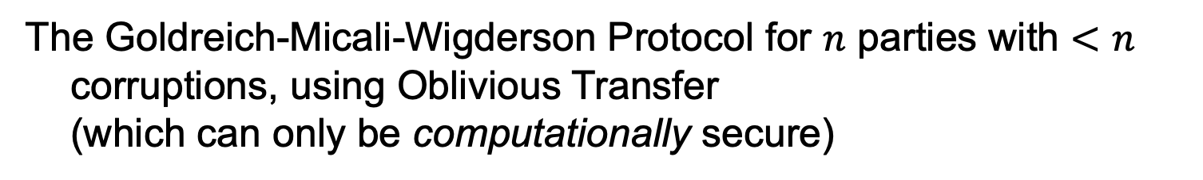
Secure Multi-party Computation
x
y
z
GMW protocol: $n−1$ out of $n$ corruptions
The Goldreich-Micali-Wigderson Protocol for $n$ parties with $<n$ corruptions, using Oblivious Transfer (which can only be computationally secure)

Slide 16


Secure Multi-party Computation
x
y
z
TODAY: HONEST MAJORITY
Information-theoretically Secure Protocols for $n$ parties with $<n/2$ corruptions
[BenOr-Goldwasser-Wigderson’88, Chaum-Crepeau-Damgard’88, BenOr-Rabin’89]

Slide 17

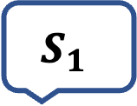
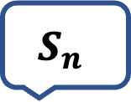
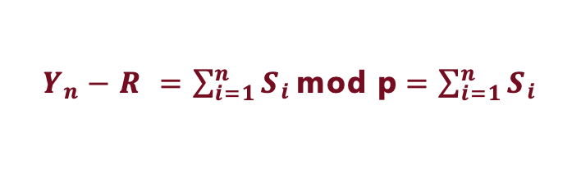
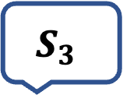
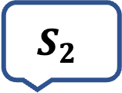
AN EXAMPLE
COMPUTING THE AVERAGE SALARY IN THIS ROOM
$$S_{1}$$
$$S_{2}$$
$$S_{3}$$
$$S_{n}$$
Y₁
Y₂
…
Y_{n-1}
SACHA
LALI
APARNA
VINOD
Y₁ = R+S₁ mod p
Y₂ = Y₁+S₂ mod p
Y₃ = Y₂+S₃ mod p
Y_{n} = Y_{n-1}+S_{n} mod p
Y_{n}
$Y_{n}−R =\sum_{i=1}^{n}{S_{i}}\text{mod} \text{p}$ $=\sum_{i=1}^{n}{S_{i}}$
Is this secure?
_{(if p large enough)}
Notes:
No, a collusion of two parties can recover a party’s secret salary.

Slide 18
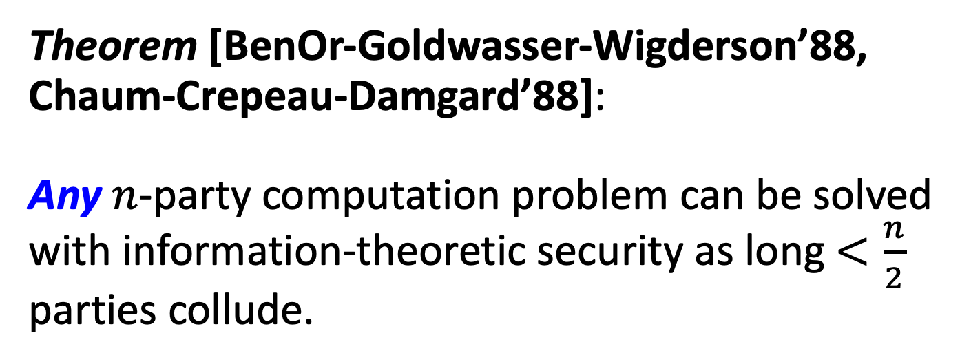
IT-Secure MPC with Honest Majority
Theorem [BenOr-Goldwasser-Wigderson’88, Chaum-Crepeau-Damgard’88]:
Any $n$-party computation problem can be solved with information-theoretic security as long $<\frac{n}{2}$ parties collude.
Key Tool: Shamir’s Secret Sharing

Slide 19




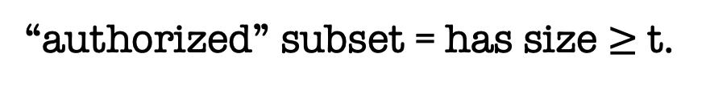
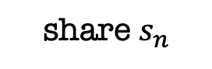


secret b
Key Tool: Secret-Sharing
share $s_{1}$
share $s_{2}$
share $s_{3}$
share $s_{4}$
share $s_{n}$
$$…$$
$$P_{1}$$
$$P_{2}$$
$$P_{3}$$
$$P_{4}$$
$$P_{n}$$
Dealer
Any “authorized” subset of players can recover b.
No other subset of players has any info about b.
Threshold (or t-out-of-n) SS [Shamir’79, Blakley’79]:
“authorized” subset = has size $≥$t.
Notes:
Information theoretic privacy
Clearly this has to be monotone

Slide 20
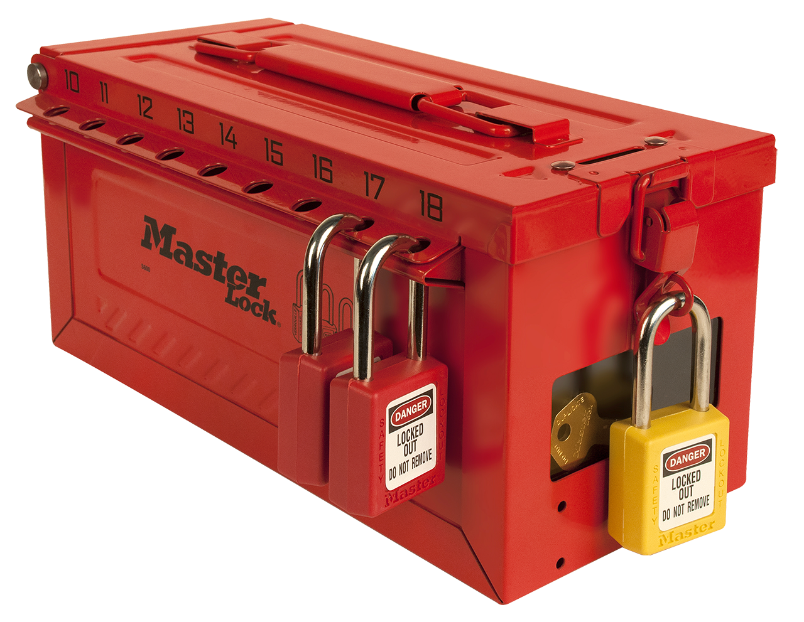
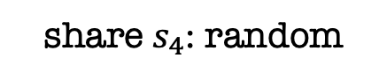

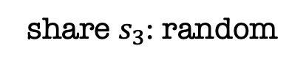
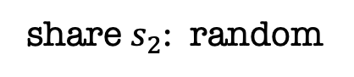
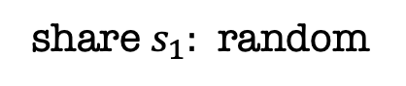
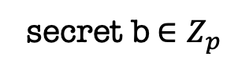
secret b$∈Z_{p}$
$n$-out-of-$n$ Secret Sharing
$$…$$
$$P_{1}$$
$$P_{2}$$
$$P_{3}$$
$$P_{4}$$
$$P_{n}$$
Dealer
share $s_{1}:$ random
share $s_{2}$: random
share $s_{3}$: random
share $s_{4}$: random
$$…$$
share $s_{n}=b−(s_{1}+s_{2}+…+s_{n−1})$ mod p
Notes:
Information theoretic privacy
Clearly this has to be monotone

Slide 21






secret b$∈Z_{p}$
$1$-out-of-$n$ Secret Sharing
$$…$$
$$P_{1}$$
$$P_{2}$$
$$P_{3}$$
$$P_{4}$$
$$P_{n}$$
Dealer
share $s_{1}=b$
share $s_{2}=b$
share $s_{3}=b$
share $s_{4}=b$
$$…$$
share $s_{n}=b$
Notes:
Information theoretic privacy
Clearly this has to be monotone

Slide 22

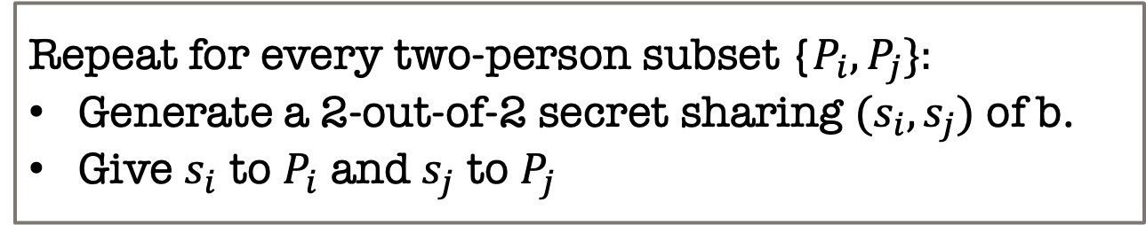
secret b$∈Z_{p}$
$2$-out-of-$n$ Secret Sharing?
$$…$$
$$P_{1}$$
$$P_{2}$$
$$P_{3}$$
$$P_{4}$$
$$P_{n}$$
Dealer
Here is a solution.
Repeat for every two-person subset {$P_{i},P_{j}\}:$
Generate a 2-out-of-2 secret sharing $(s_{i},s_{j})$ of b.
Give $s_{i}$ to $P_{i}$ and $s_{j}$ to $P_{j}$
What is the size of shares each party gets?
How does this scale to t-out-of-n?
Notes:
Information theoretic privacy
Clearly this has to be monotone

Slide 23
Shamir’s t-out-of-n Secret Sharing
Key Idea: Polynomials are Amazing!

Slide 24
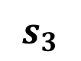
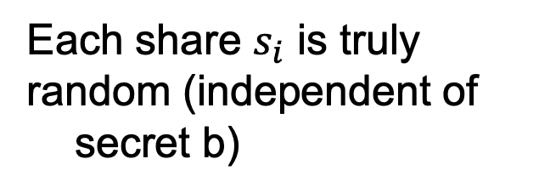
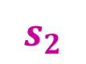
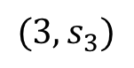
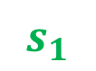
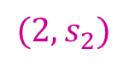
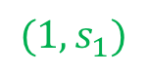
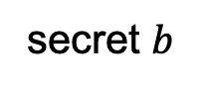
Shamir’s 2-out-of-n Secret Sharing
$$s_{1}$$
$$s_{2}$$
random line through (0,b)
$$(3,s_{3})$$
$$(2,s_{2})$$
$$s_{3}$$
$$(1,s_{1})$$
secret $b$
Each share $s_{i}$ is truly
random (independent of secret b)
Any two shares uniquely
determine b.

Slide 25
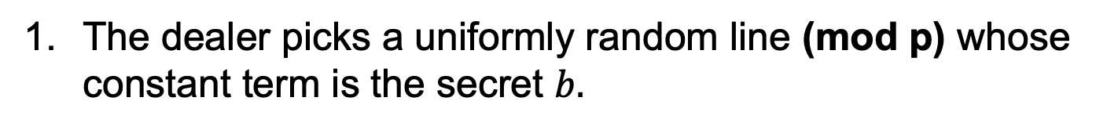
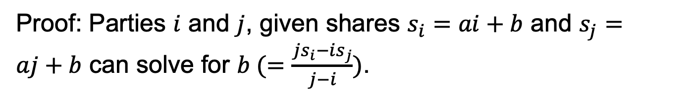
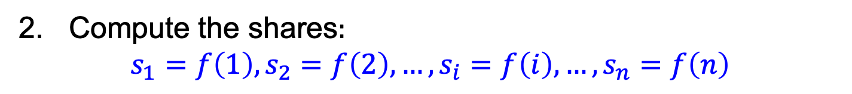
Shamir’s 2-out-of-n Secret Sharing
The dealer picks a uniformly random line (mod p) whose constant term is the secret $b.$
$f\left(x\right)=ax+b$ where $a$ is uniformly random mod $p$
2. Compute the shares$:$ $$s_{1}=f\left(1\right),s_{2}=f\left(2\right),…,s_{i}=f\left(i\right),{…,s}_{n}=f\left(n\right)$$
Correctness: can recover secret from any two shares.
Proof: Parties $i$ and $j$, given shares $s_{i}=ai+b$ and $s_{j}=aj+b$ can solve for $b (=\frac{js_{i}−is_{j}}{j−i})$.

Slide 26
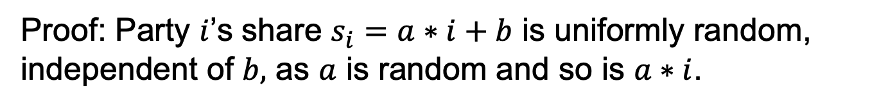
Shamir’s 2-out-of-n Secret Sharing
The dealer picks a uniformly random line (mod p) whose constant term is the secret $b.$
$f\left(x\right)=ax+b$ where $a$ is uniformly random mod $p$
2. Compute the shares$:$ $$s_{1}=f\left(1\right),s_{2}=f\left(2\right),…,s_{i}=f\left(i\right),{…,s}_{n}=f\left(n\right)$$
Security: any single party has no information about the secret.
Proof: Party $i$’s share $s_{i}=a∗i+b$ is uniformly random, independent of $b,$ as $a$ is random and so is $a∗i$.

Slide 27
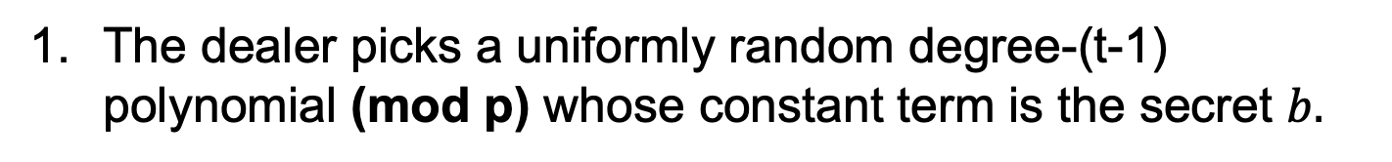
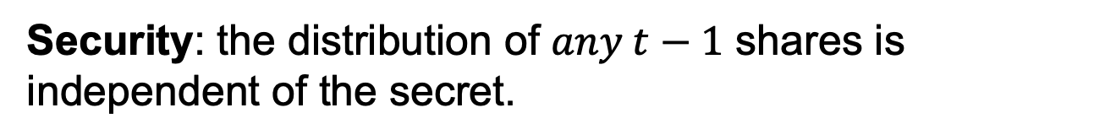
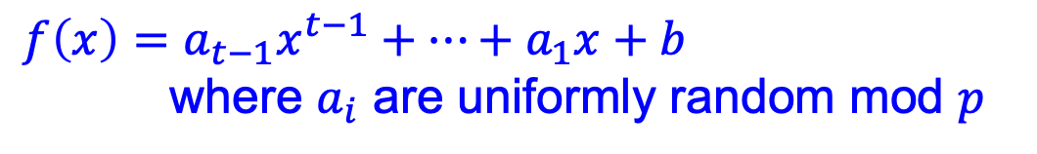
Shamir’s t-out-of-n Secret Sharing
Key Idea: Polynomials are Amazing!
The dealer picks a uniformly random degree-(t-1) polynomial (mod p) whose constant term is the secret $b.$
$f\left(x\right)=a_{t−1}x^{t−1}+…+a_{1}x+b$ where $a_{i}$ are uniformly random mod $p$
2. Compute the shares$:$ $$s_{1}=f\left(1\right),s_{2}=f\left(2\right),…,s_{i}=f\left(i\right),{…,s}_{n}=f\left(n\right)$$
Correctness: can recover secret from any $t$ shares.
Security: the distribution of $any t−1$ shares is independent of the secret.
Note: need p to be larger than the number of parties n.

Slide 28
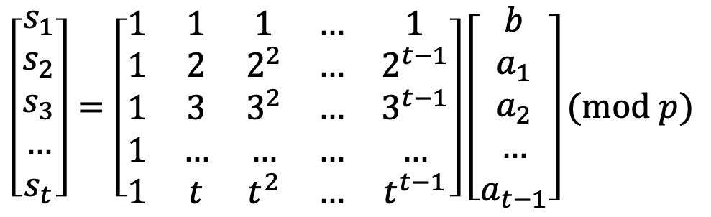
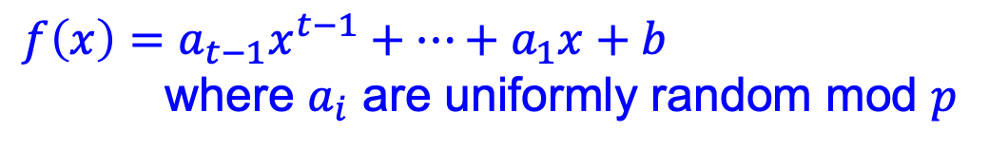
Shamir’s t-out-of-n Secret Sharing
Key Idea: Polynomials are Amazing!
$f\left(x\right)=a_{t−1}x^{t−1}+…+a_{1}x+b$ where $a_{i}$ are uniformly random mod $p$
$$s_{1}=f\left(1\right),s_{2}=f\left(2\right),…,s_{i}=f\left(i\right),{…,s}_{n}=f\left(n\right)$$
Correctness: via Vandermonde matrices.
Let’s look at shares of parties $P_{1},P_{2},…,P_{t}.$
$$\left[\begin{matrix}s_{1} \\ s_{2} \\ s_{3} \\ … \\ s_{t}\end{matrix}\right]=\left[\begin{matrix}1 & 1 & 1 & … & 1 \\ 1 & 2 & 2^{2} & … & 2^{t−1} \\ 1 & 3 & 3^{2} & … & 3^{t−1} \\ 1 & … & … & … & … \\ 1 & t & t^{2} & … & t^{t−1}\end{matrix}\right]\left[\begin{matrix}b \\ a_{1} \\ a_{2} \\ … \\ a_{t−1}\end{matrix}\right](mod p)$$
$t$-by-$t$ Vandermonde matrix which is invertible

Slide 29
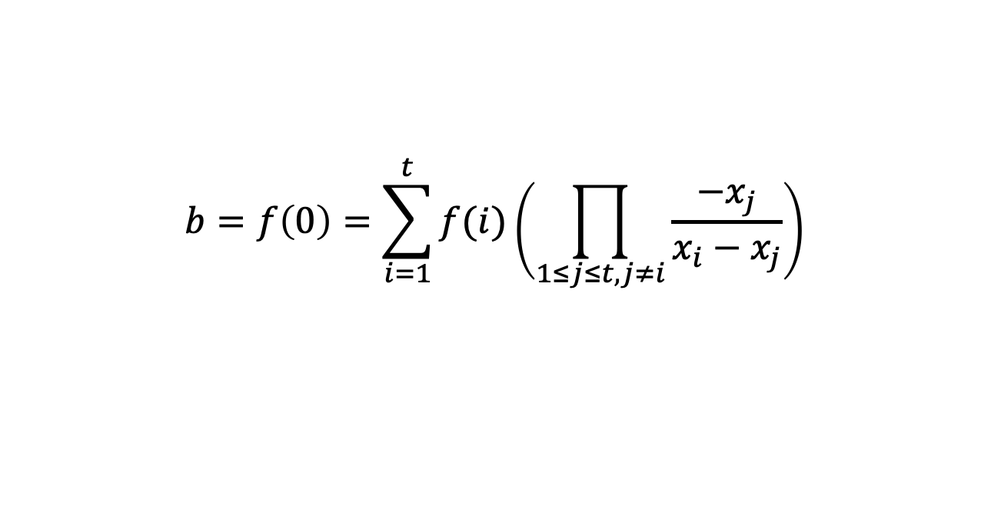
Shamir’s t-out-of-n Secret Sharing
Key Idea: Polynomials are Amazing!
$f\left(x\right)=a_{t−1}x^{t−1}+…+a_{1}x+b$ where $a_{i}$ are uniformly random mod $p$
$$s_{1}=f\left(1\right),s_{2}=f\left(2\right),…,s_{i}=f\left(i\right),{…,s}_{n}=f\left(n\right)$$
Correctness: Alternatively, Lagrange interpolation gives an explicit formula that recovers b.
$$b=f\left(0\right)=\sum_{i=1}^{t}{f(i)\left(\prod_{1≤j≤t,j≠i}{\frac{−x_{j}}{x_{i}−x_{j}}}\right)}$$

Slide 30
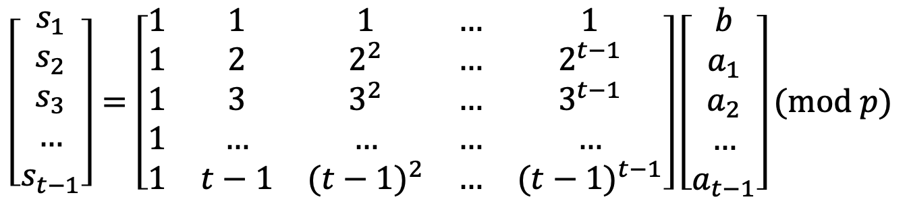
Shamir’s t-out-of-n Secret Sharing
Key Idea: Polynomials are Amazing!
$f\left(x\right)=a_{t−1}x^{t−1}+…+a_{1}x+b$ where $a_{i}$ are uniformly random mod $p$
$$s_{1}=f\left(1\right),s_{2}=f\left(2\right),…,s_{i}=f\left(i\right),{…,s}_{n}=f\left(n\right)$$
Security:
Let’s look at shares of parties $P_{1},P_{2},…,P_{t−1}.$
$$\left[\begin{matrix}s_{1} \\ s_{2} \\ s_{3} \\ … \\ s_{t−1}\end{matrix}\right]=\left[\begin{matrix}1 & 1 & 1 & … & 1 \\ 1 & 2 & 2^{2} & … & 2^{t−1} \\ 1 & 3 & 3^{2} & … & 3^{t−1} \\ 1 & … & … & … & … \\ 1 & t−1 & {(t−1)}^{2} & … & {(t−1)}^{t−1}\end{matrix}\right]\left[\begin{matrix}b \\ a_{1} \\ a_{2} \\ … \\ a_{t−1}\end{matrix}\right](mod p)$$
$(t−1)$-by-$t$ Vandermonde matrix

Slide 31
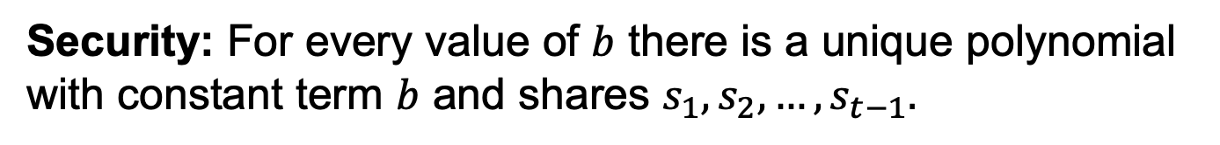
Shamir’s t-out-of-n Secret Sharing
Key Idea: Polynomials are Amazing!
$f\left(x\right)=a_{t−1}x^{t−1}+…+a_{1}x+b$ where $a_{i}$ are uniformly random mod $p$
$$s_{1}=f\left(1\right),s_{2}=f\left(2\right),…,s_{i}=f\left(i\right),{…,s}_{n}=f\left(n\right)$$
Security: For every value of $b$ there is a unique polynomial with constant term $b$ and shares $s_{1},s_{2},…,s_{t−1}.$
$$\left[\begin{matrix}s_{1} \\ s_{2} \\ s_{3} \\ … \\ s_{t−1}\end{matrix}\right]=\left[\begin{matrix}1 & 1 & 1 & … & 1 \\ 1 & 2 & 2^{2} & … & 2^{t−1} \\ 1 & 3 & 3^{2} & … & 3^{t−1} \\ 1 & … & … & … & … \\ 1 & t−1 & {(t−1)}^{2} & … & {(t−1)}^{t−1}\end{matrix}\right]\left[\begin{matrix}b \\ a_{1} \\ a_{2} \\ … \\ a_{t−1}\end{matrix}\right](mod p)$$
$(t−1)$-by-$t$ Vandermonde matrix

Slide 32
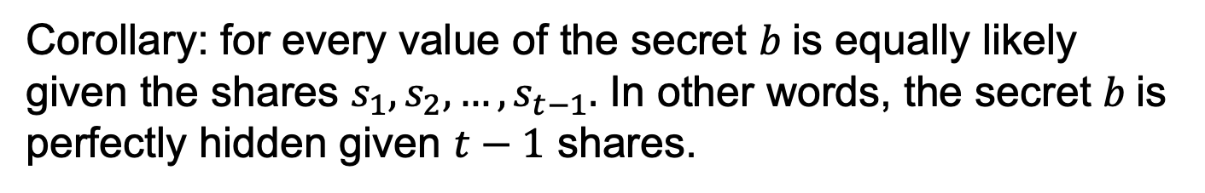
Shamir’s t-out-of-n Secret Sharing
Key Idea: Polynomials are Amazing!
$f\left(x\right)=a_{t−1}x^{t−1}+…+a_{1}x+b$ where $a_{i}$ are uniformly random mod $p$
$$s_{1}=f\left(1\right),s_{2}=f\left(2\right),…,s_{i}=f\left(i\right),{…,s}_{n}=f\left(n\right)$$
Security: For every value of $b$ there is a unique polynomial with constant term $b$ and shares $s_{1},s_{2},…,s_{t−1}.$
Corollary: for every value of the secret $b$is equally likely given the shares $s_{1},s_{2},…,s_{t−1}.$ In other words, the secret $b$is perfectly hidden given $t−1$ shares.

Slide 33
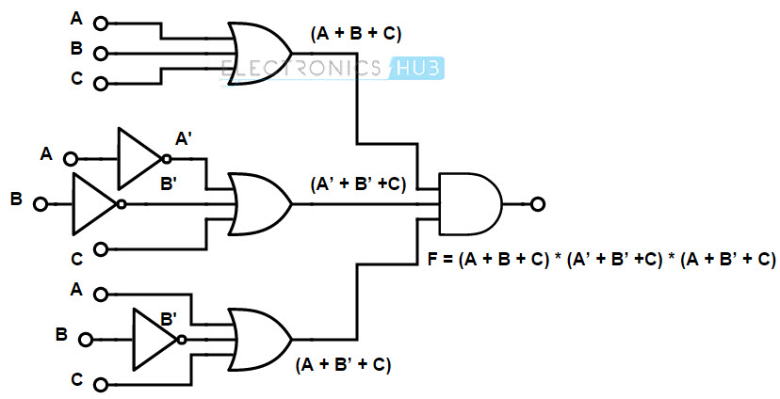
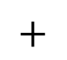

Secure Multiparty Computation
[BenOr-Goldwasser-Wigderson’88, Chaum-Crepeau-Damgard’88, BenOr-Rabin’89]
x
y
$$+$$
$$×$$
z
Arithmetic circuit for F
1. Each party secret-shares their input on a degree-t polynomial.
// so, security against t corruptions
2. Proceed gate by gate, maintaining the invariant that the parties holds a secret sharing of every wire value.
3. Exchange the output shares & reconstruct the output.

Slide 34
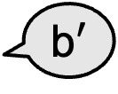
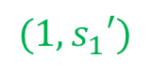
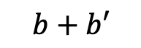

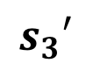
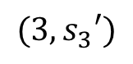
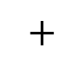
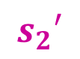
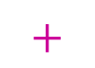
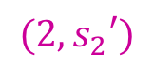




Secure Multiparty Computation
Key Insight: Can homomorphically compute on shares!
$$b$$
b$′$
$$s_{1}$$
$$s_{2}$$
$$b+b′$$
$$+$$
$$+$$
$$(3,s_{3})$$
$$s_{1}′$$
$$s_{2}′$$
$$(2,s_{2})$$
$$s_{3}$$
$$(1,s_{1})$$
$$+$$
$$b$$
$$s_{3}′$$
$$(3,s_{3}′)$$
$$(2,s_{2}′)$$
$$(1,s_{1}′)$$
Addition gate:
$$b′$$
Locally add shares

Slide 35







Secure Multiparty Computation
Key Insight: Can homomorphically compute on shares!
$$b$$
b$′$
degree-2 poly through (0,$s×s′$)
$$s_{1}$$
$$s_{2}$$
$$×$$
$$×$$
$$b×b′$$
$$(3,s_{3})$$
$$s_{1}′$$
$$s_{2}′$$
$$(2,s_{2})$$
$$s_{3}$$
$$(1,s_{1})$$
$$×$$
$$b$$
$$s_{3}′$$
$$(3,s_{3}′)$$
$$(2,s_{2}′)$$
$$(1,s_{1}′)$$
Multiplication gate:
$$b′$$
Locally multiply shares

Slide 36


Multiplication
In general, after a single multiplication, the shares will live on a degree-2t polynomial.
Need $2t+1$ shares to reconstruct.
We know that $n>2t$, so the n shares together have enough information to recover the product of the secrets!
What’s more, we also know that this recovery process is a linear function of the shares.
b$×b′=\sum{λ_{i}}s_{i}s_{i}′$
for some publicly known coefficients $λ_{i}$.

Slide 37








Degree Reduction Protocol
$$b$$
b$′$
degree-2 poly through (0,$s×s′$)
$$s_{1}$$
$$s_{2}$$
$$s_{1}′′$$
$$s_{2}′′$$
$$×$$
$$×$$
$$b×b′$$
Fortunately: $$b×b^{′}=\sum{λ_{i}}s_{i}s_{i}′$$
$$s_{1}′$$
$$s_{2}′$$
$$s_{3}$$
$$(1,s_{1}′′)$$
$$s_{3}′′$$
$$×$$
$$s_{3}′$$
$$(2,s_{2}′′)$$
Multiplication gate:
$$(3,s_{3}′′)$$
Locally multiply shares & run a degree reduction protocol.

Slide 38





Degree Reduction Protocol
Convert shares on a degree-2t polynomial into shares on a degree-t polynomial
Idea: “homomorphically” compute the linear function $\sum{λ_{i}}∗(∙)$ on the local product shares.
1. Each party t-out-of-n shares $s_{i}×s_{i}′$ to all parties
$$s$$
$$s′$$
$$s_{1}$$
$$s_{2}$$
2. Each party computes a linear combination of the shares it receives using coefficients $λ_{i}$.
$$×$$
$$×$$
$$s_{1}′$$
$$s_{2}′$$
$$s_{3}$$
$$×$$
$$s_{3}′$$

Slide 39
This is the moral equivalent of bootstrapping in FHE!
Idea: “homomorphically” compute the linear function $\sum{λ_{i}}∗(∙)$ on the local product shares.
1. Each party t-out-of-n shares $s_{i}×s_{i}′$ to all parties
$$s$$
$$s′$$
$$s_{1}$$
$$s_{2}$$
2. Each party computes a linear combination of the shares it receives using coefficients $λ_{i}$.
$$×$$
$$×$$
$$s_{1}′$$
$$s_{2}′$$
$$s_{3}$$
$$×$$
$$s_{3}′$$

Slide 40



Secure Multiparty Computation
x
y
$$+$$
$$×$$
z
Arithmetic circuit for F
1. Each party secret-shares their input.
2. Proceed gate by gate: ADD: locally add shares MULT: locally mult shares and do degree reduction.
3. Exchange the output shares & reconstruct the output.
Communication Complexity $∝$ #AND gates

Slide 41
Security Intuition
1. Any subset of t parties do not get any information about other parties’ inputs from the input shares.
2. Security of the degree-reduction protocol: any subset of t parties sees completely random numbers
3. The output lives on a random polynomial of degree t whose constant term is the circuit output. The shares, therefore, reveal only the circuit output.

Slide 42
Threshold Decryption and Signing
Secret sharing is useful way beyond MPC.
An example: distributed storage of keys.
Another example, threshold decryption: distributed storage of decryption key + non-interactive distributed (or threshold) decryption

Slide 43



Threshold El Gamal
Public key: $g^{x}$
Secret key: $x$
I am paranoid about losing x so I share it among n servers.
I secret-share x into n shares $x_{1},…,x_{n}$ s.t. $\sum_{i=1}^{n}{x_{i}}=x (mod q)$
Threshold Decryption:
Given a ciphertext $(g^{r},g^{rx}m)$, the servers each compute a decryption share ${(g^{r})}^{x_{i}}.$
Multiplying the decryption shares gives us $\prod{{(g^{r})}^{x_{i}}}=g^{rx}$ which in turn gives us $m$ after division.

Slide 44
Threshold Decryption and Signing
Secret sharing is useful way beyond MPC.
An example: distributed storage of keys.
Another example, threshold decryption: distributed storage of decryption key + non-interactive distributed (or threshold) decryption
Yet another example, threshold signing.

Slide 45


Slide 46



Slide 47



